Slide 1
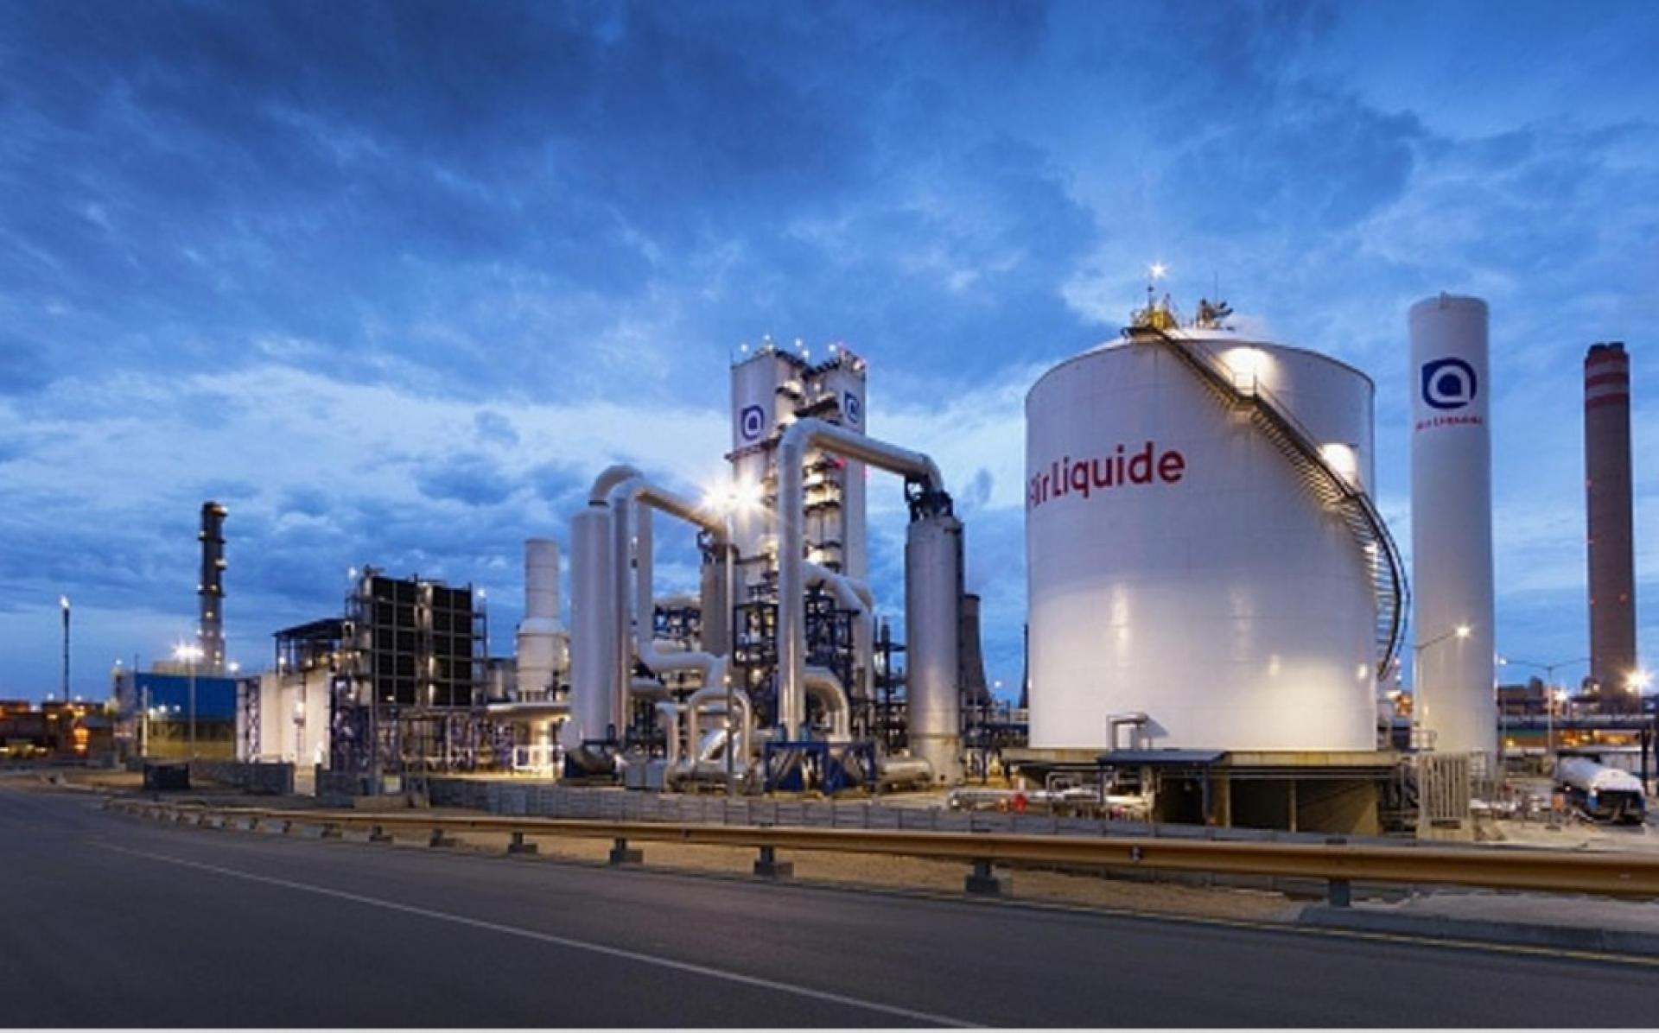

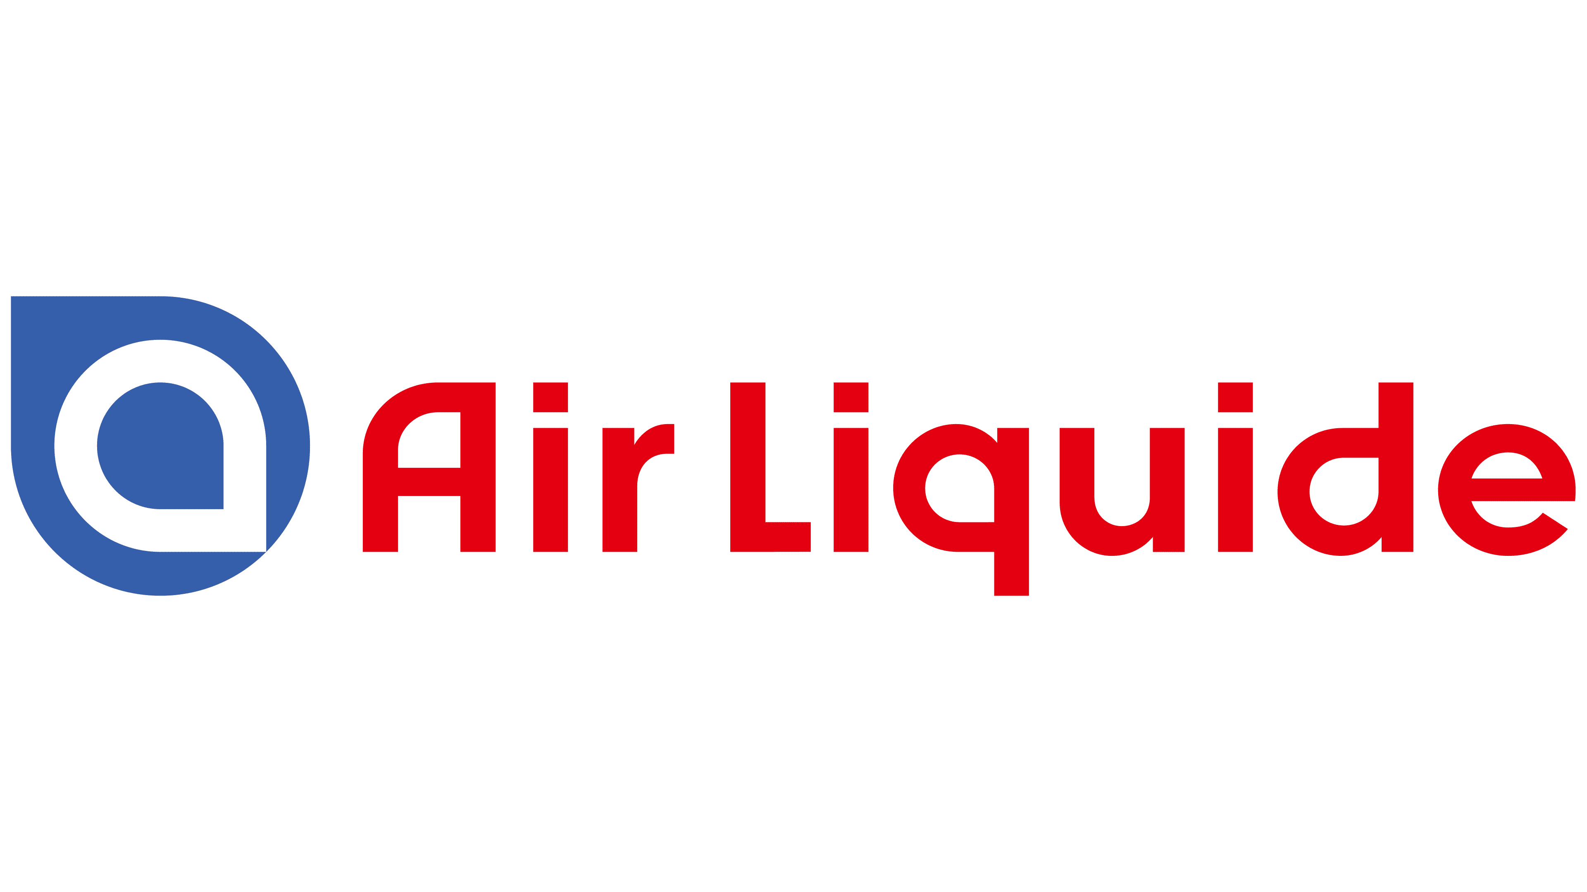
Air Liquide (XPAR: AI)

Slide 2


Executive Summary
Key Facts
Valuation Summary
Founded in 1902, Air Liquide is a leading industrial and medical gases, technologies and services provider globally.
The firm offers core industrial gases (oxygen, hydrogen & nitrogen) used in AI microchips and industrial speciality applications (e.g. welding, diving & medical equipment).
Industries span across engineering & technologies, industrials, healthcare and electronics.
Price Target: €193.96
Implied Upside: 16.9%
Valuation Methodology Used: DCF; Terminal Value (Perpetuity Growth Method)
LTM EV/EBITDA | LTM Yield: 15.3x | 6.53%
Key Insights
Patented Speciality Gas Applications
Reliability-backed AI Upside
Volatility Managed Risk Profile
Investment Rationale
Thesis 1: Capitalising on AI and semiconductor demand
  Deriving demand for Air Liquide gases as the co-head producer of gases required for semiconductors used in AI
  Mitigation of AI bubble-bursting concerns through optionality, offered by diverse utilisation of semiconductors
Thesis 2: Reliability of Air Liquide’s non-cyclical factors
  Stable and significant revenue from the healthcare sector and take-or-pay contracts
  Green projects: Carbon Capture, ammonia cracking, and entering the green hydrogen market
We recommend a BUY rating for Air Liquide with a price target of €193.96, indicating a 16.9% upside.

Slide 3
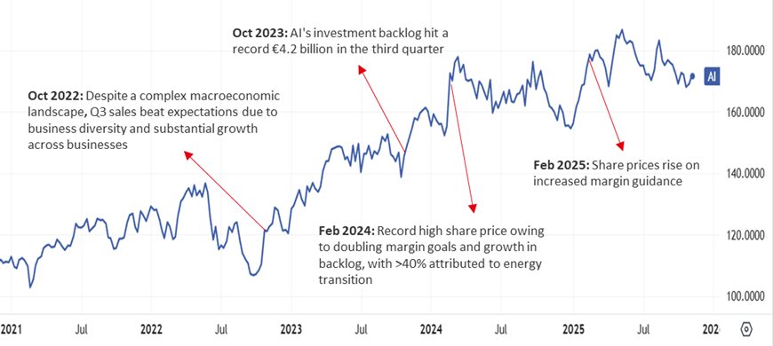
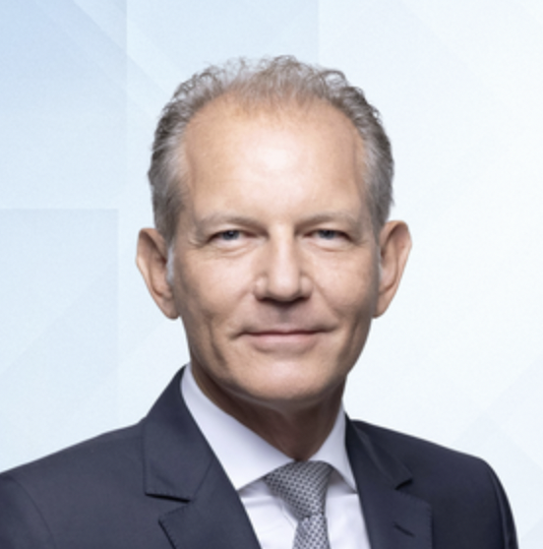

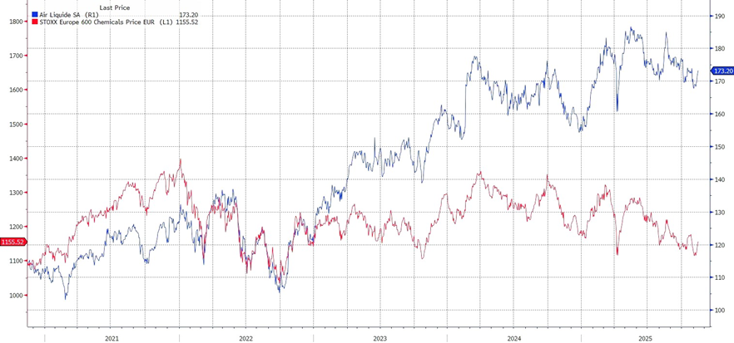
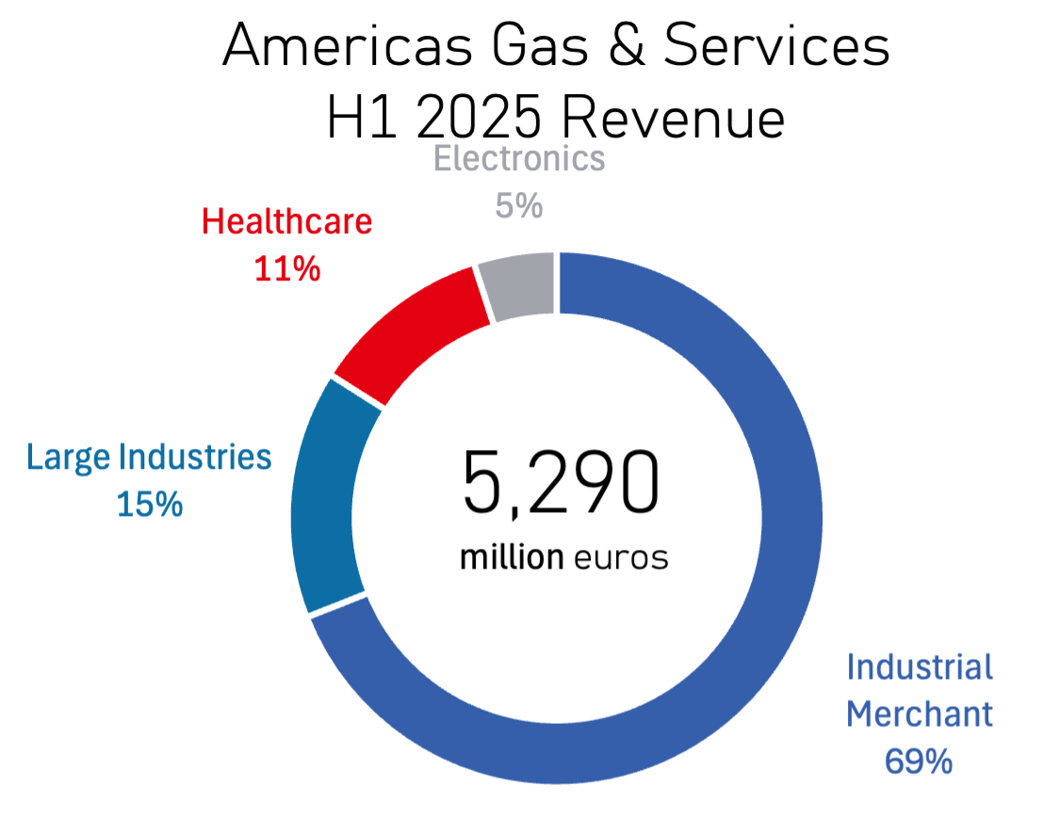
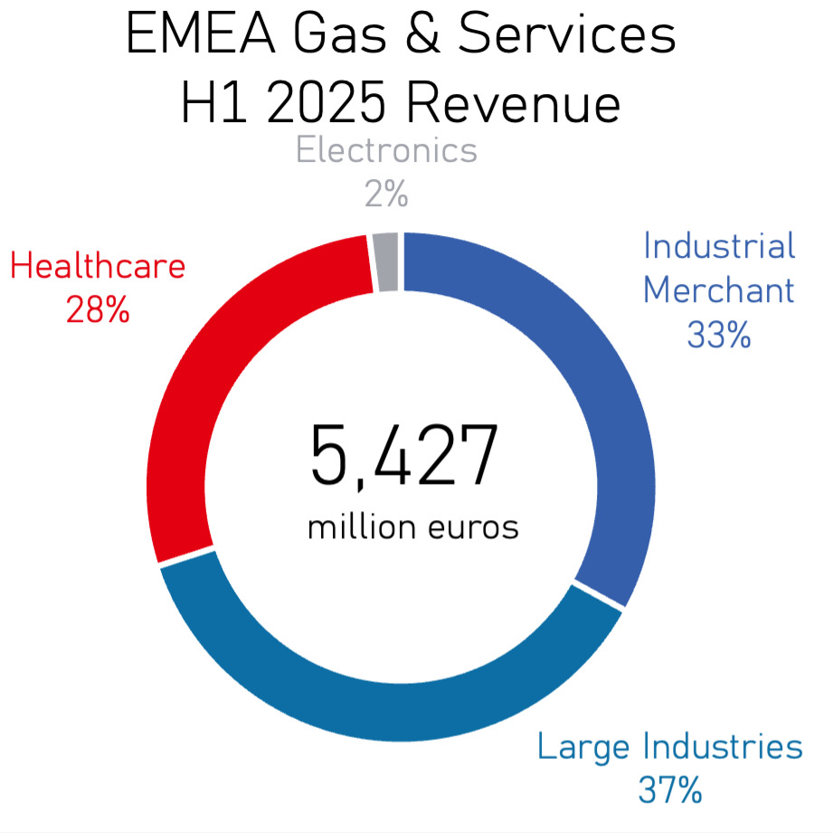
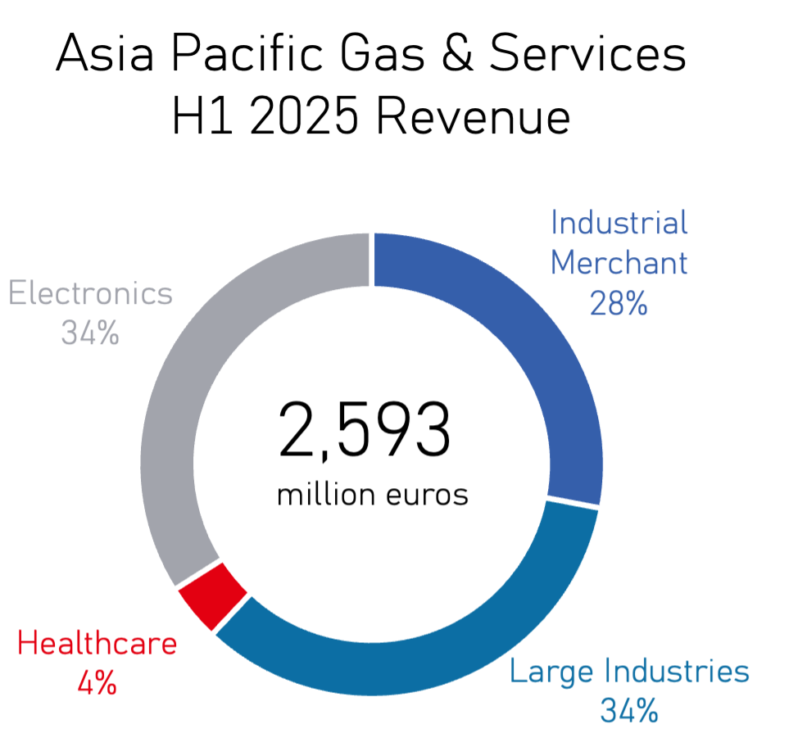
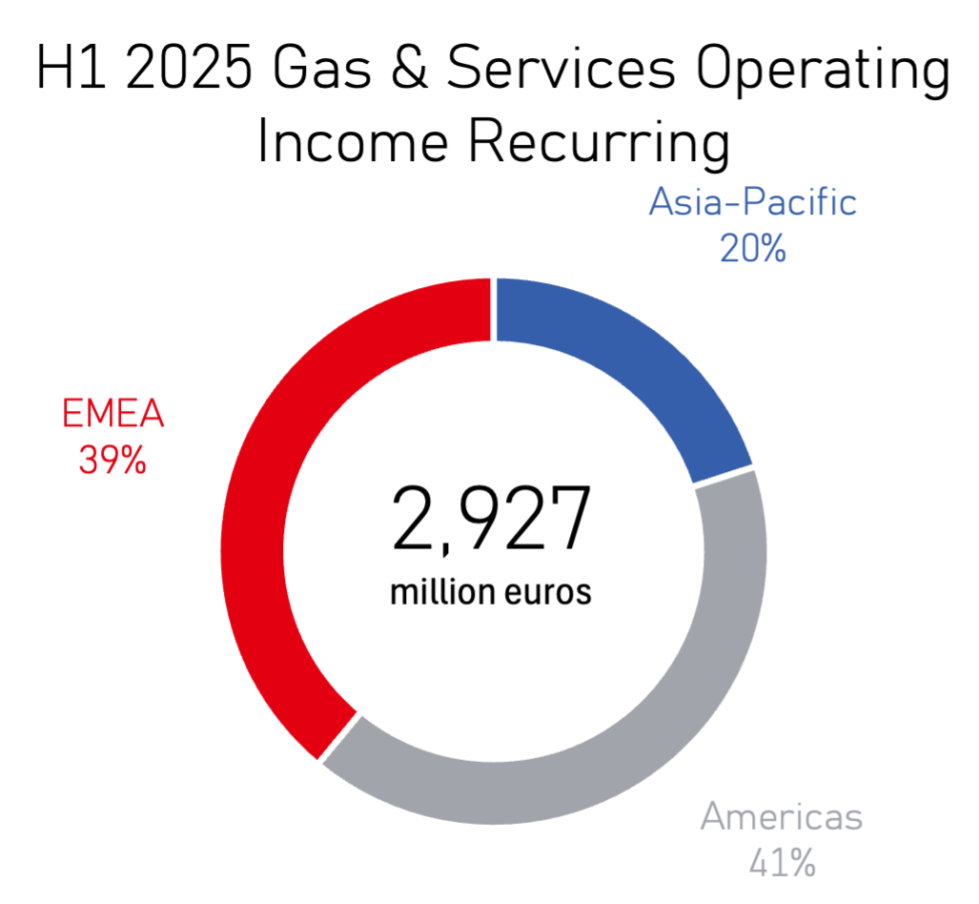
Company Overview & Share Performance
Investment & Company Overview
Air Liquide, founded in 1902, currently operates in over 70 countries. They are the second largest suppliers of industrial gases by revenue, supplying various industries including medical, industrial, and electronic manufacturing.
Air Liquide 5-year Share Performance and Chart Analysis
François Jackow – CEO
Appointed in 2022, having joined Air Liquide 20 years prior. Previous experience within Air Liquide includes CMO of R&D/Innovation, Japan CEO, and Head of Large Industries.
Jérôme Pelletan – CFO
Appointed in 2021, having joined Air Liquide in 2006. Previously CFO in Taiwan, Latin America, and the Americas Hub at Air Liquide, with experience in financial management roles at Deloitte, Accor and Hermès.
Business Model: Air Liquide produces and distributes industrial, medical, and specialty gases through long-term contracts and on-site systems. The company holds a leading global market share, operates a highly integrated production network, and maintains strong cash flows supporting large scale clean energy projects.
Strategy: After reinforcing its position as one of the largest industrial gas providers, Air Liquide has continued to consolidate its market presence. The company is leveraging multibillion-dollar annual capex and R&D programs to expand into hydrogen, biomethane, carbon-capture, and advanced electronics gases supporting semiconductor growth.
Differentiating Factors: Air Liquide’s entrenched infrastructure, long-duration contracts, and high switching costs make its market share extremely defensible. Its early leadership in hydrogen and essential role across healthcare and industrial supply chains, further strengthen its competitiveness in the sector.
5-year Stock Performance vs STOXX Europe 600 Chemicals Index

Slide 4
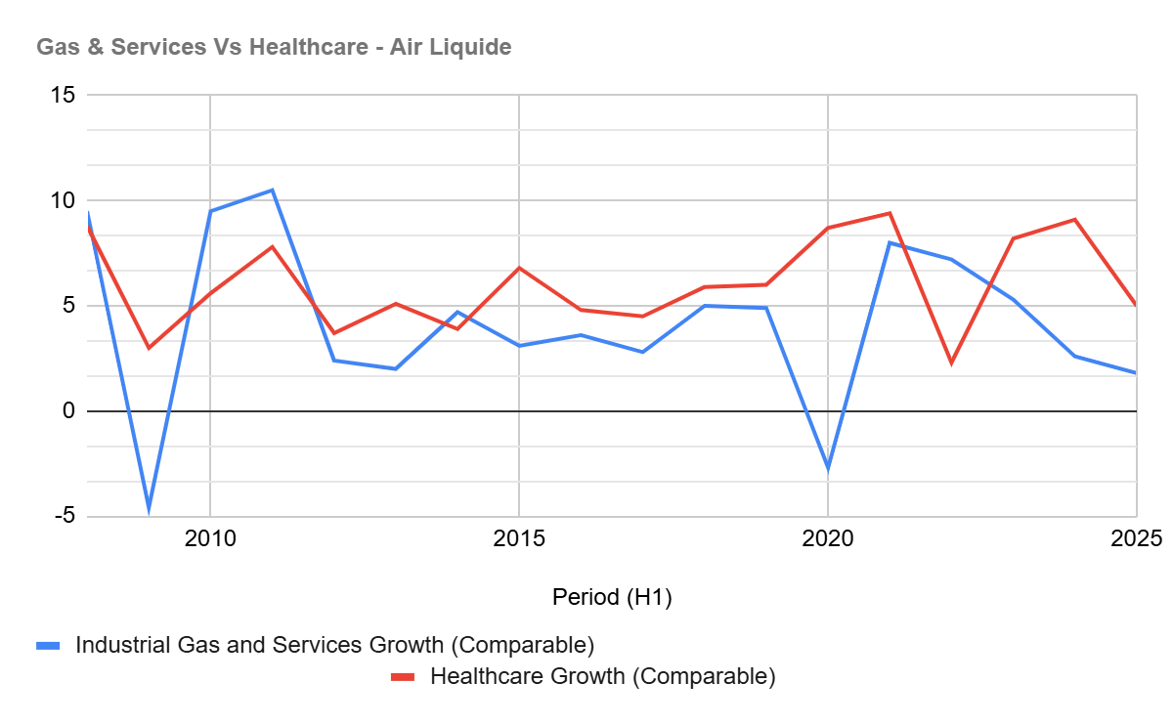
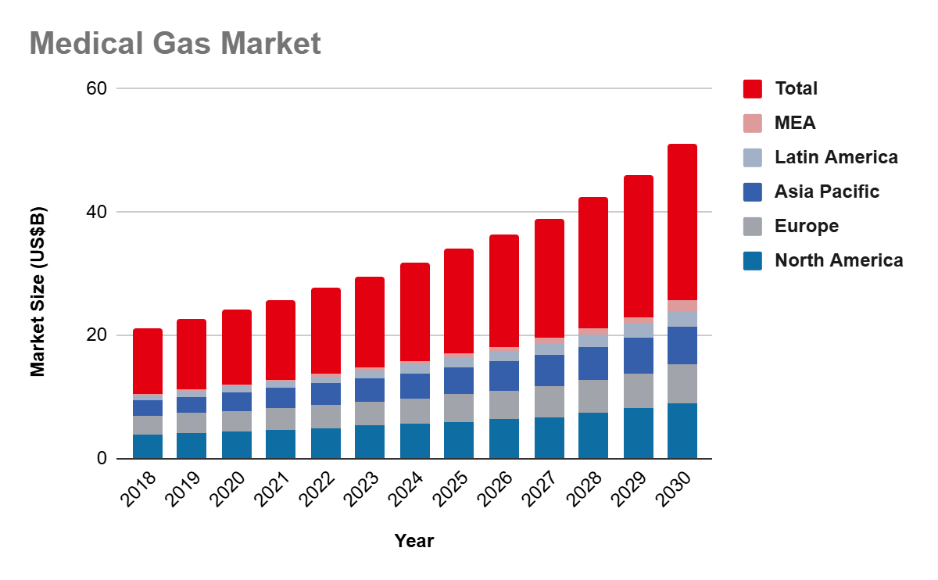
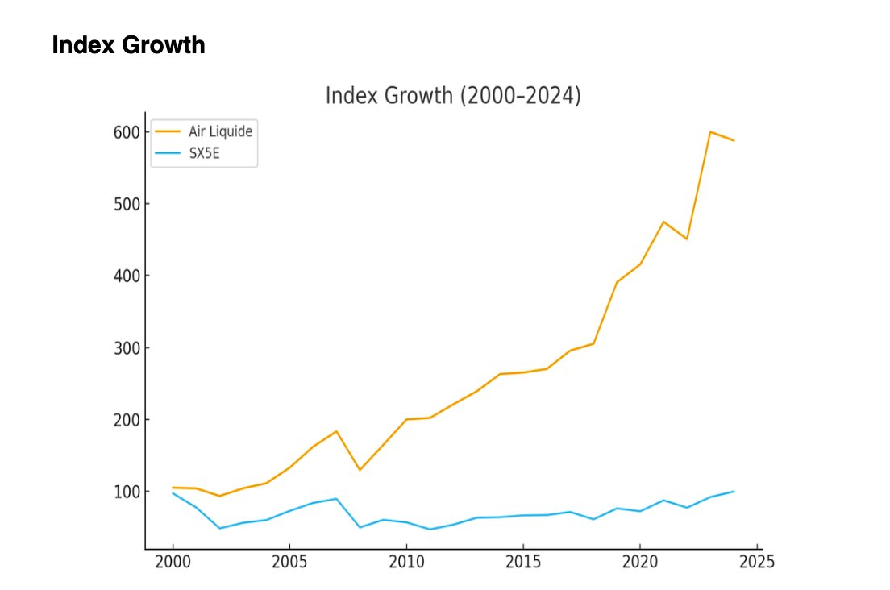
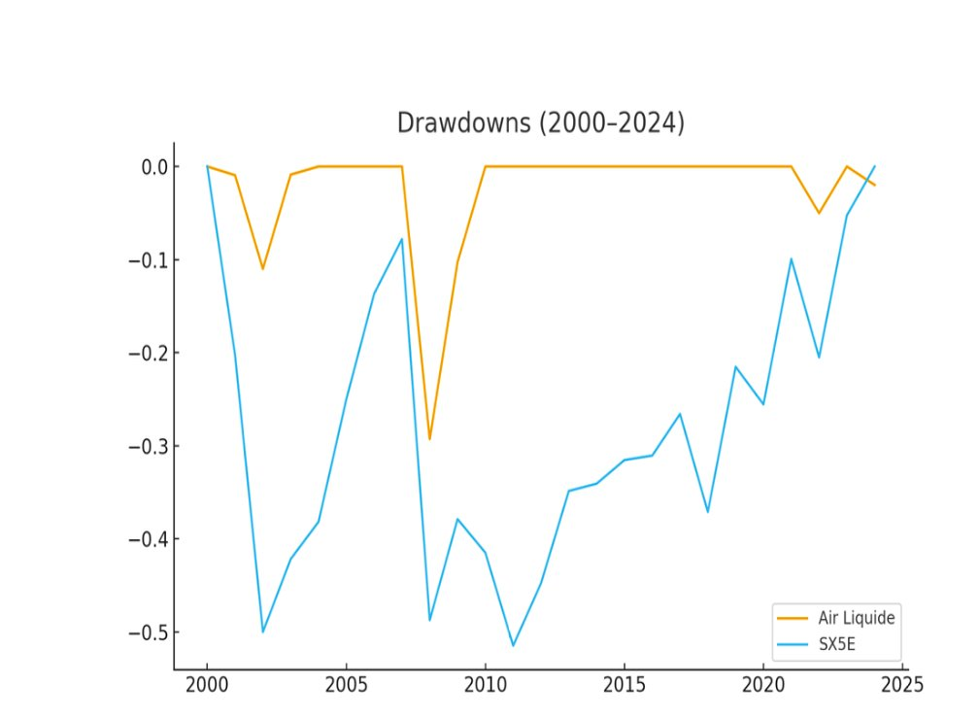
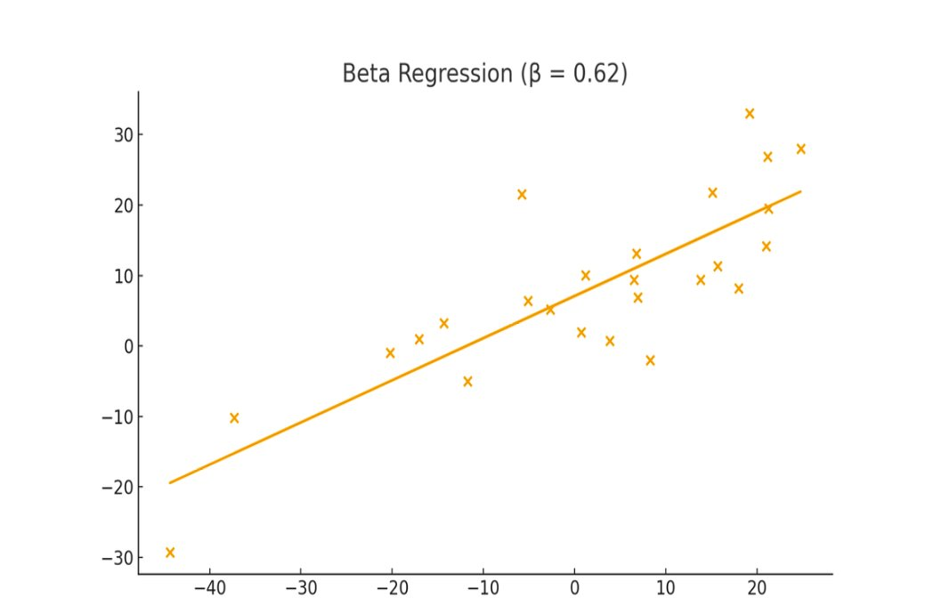



Market Structure & Growth Trajectory
Air Liquide is well-positioned for AI growth, secured by robust non-cyclical segments.
Competitive Landscape
Financial Resilience
Air Liquide has significantly outperformed the SX5E with shallower drawdowns and a defensive profile (β ≈ 0.62), indicating strong, steady growth with lower sensitivity to market swings.
Air Products
& Chemicals
Linde PLC
Air Liquide
Nippon Sanso Holdings
Linde plc (LIN): Closest competitor of Air Liquide with a market capitalisation of $198 Billion. Large new focus on clean hydrogen and decarbonization.
Air Products & Chemicals (APD): Capital-intensive industrial gas supplier focused on mega-scale projects, with a market capitalisation of $57.84 Billion.
Nippon Sanso Holdings: dominant Asian industrial gas supplier with the highest structural revenue concentration in high-growth Electronics sectors
Air Liquide relies on its strong healthcare sector to offset industrial gas market recessions, a pattern evident in the downturns of 2008-2009, 2020 and 2022.
Air Liquide ensures its financial stability and resilience through contractual revenue commitments that protects margins, strategic diversification via its enduring healthcare segment (to counterbalance industrial downturns), and operational discipline focused on efficiency and sustained investment for future margin improvement.
Air Liquide exhibits a highly stable competitive position and defensive financial characteristics, using its non-cyclical strength to provide a negative beta against the European benchmark (SX5E).

Slide 5
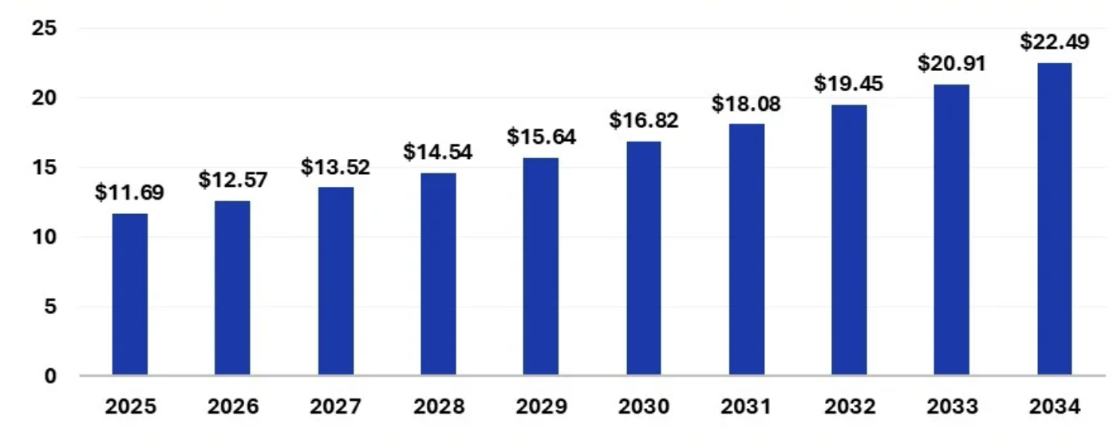
Investment Thesis I: A “Picks & Shovels” play on AI
The Picks & Shovels
Leading supplier of innovative and patented speciality gas applications in the semiconductor sector; essential for fabrication of high-performance microchips, AI’s backbone.
Global infrastructure projects, worth $1.5bn of investment backlog, with contracts supplying major semiconductor players.
Projected semiconductor gas market (billions)
Moated Growth
Global footholds in key markets (Asia and USA) and developing markets (Europe).
Dominance and expertise over a crucial pillar of microchip production uniquely positions Air Liquide to fully harness the semiconductor supercycle.
Optionality provided by infrastructure minimises the impact of AI ‘bubble’ concerns; microchips are used in most electronics, so manufacturing infrastructure holds value.
Growth tailwinds from AI & semiconductor industries:
Semiconductor gas market size set to double over the next decade (CAGR 7.5%).
The electronics industry represented roughly 10% of AL’s revenue in 2024; a figure we expect to grow in tandem with the semiconductor industry.
First industrial player to supply cutting-edge, greener microchip manufacturing: tungsten alternative.

Slide 6
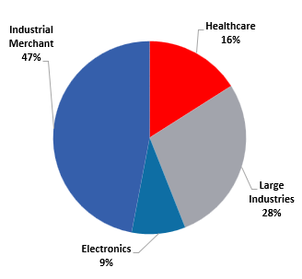
Investment Thesis II: Stability, Sustainability & Guaranteed Growth
Air Liquide’s resilience and future growth prospects standalone as a thesis.
Stability-MOAT-Pillars and Strategies
Q3 2025
Solid financials + recurring efficiency gains
Partnerships, infrastructure and take-or-pay contracts
Healthcare: portfolio balance and diversification
Strong investment momentum: backlog ($4.6bn)
Green transition (hydrogen):
  Early-bird advantage
  Infrastructure leverage
  Partnerships
  Expertise
AL on target to increase Operating Margin +460 basis points by 2026
Rev. Breakdown YTD (June 2025)
44% of revenue in healthcare and take-or-pay contracts
Investments in semiconductors backed by contracts, notably: Germany, USA, and Singapore
Historical pricing power offsets energy price volatility
Strong financials despite a recently difficult climate
Patented CryoCap tech + Ammonia cracking pilot
Partnerships to help large MNC’s decarbonize
$1.8bn investment + EU & US subsidies:
  200MW in France
  200MW + 150MW in Netherlands
  Infra. leverage in Gulf of Mexico
Foothold in emerging green hydrogen market with entry barriers (15.33% CAGR by 2030).
Green
Stable Revenue
Conclusion: Air Liquide will ride the AI ‘wave’, weather the ‘storm’, and find ‘greener’ land. All more effectively than its peers.

Slide 7
Risk Analysis
Considerations and Mitigants
Risk | Description
Market | Margins depend on electricity and natural gas prices: volatile Uses ‘take-or-pay’ contracts (renegotiation risk remains) FX Exposure — currency volatility can affect reported earnings Air Liquide uses natural hedging
Financial | Significant long-term debt to finance large capex projects Interest Coverage: 36.2x Most key central banks are not expected to increase interest rates Project execution delays and weak demand can cause returns to come later than planned History of delivering on complex projects
Legal | Oligopoly market: regulatory pattern to hinder M&As e.g. the 2016 Airgas acquisition required a $781mn forced divestiture to a competitor (Matheson Tri-Gas) to satisfy the US FTC Rely on organic investment for growth, supported by subsidies Projects are vulnerable to “climate-washing” lawsuits e.g. A 2024 Dutch court ruled that Airline KLM’s sustainability advertising was “misleading”, setting a European precedent for challenging corporate green claims in court AL have released a strategic plan on how to achieve carbon neutrality by 2050, with markers along the timeline, granting protection to this narrative
ESG | Blue Hydrogen (Steam Methane Reforming + CCS) attacked by critics: “false solution” and “not clean” 45Q tax credits protects cash flows - generating capital to fund green hydrogen business Green Transition: increased demand for skilled workers, 7 million global shortage by 2030 (BCG) Selected partner for 6/7 U.S DoE Clean Hydrogen Hubs which is attractive to future talent "ADVANCE" plan seen as too aspirational: investments not linked to quantified emission reductions, lower ESG rating, undermining credibility Managed also by the strategic plan on carbon neutrality by 2050, with markers along the timeline

Slide 8
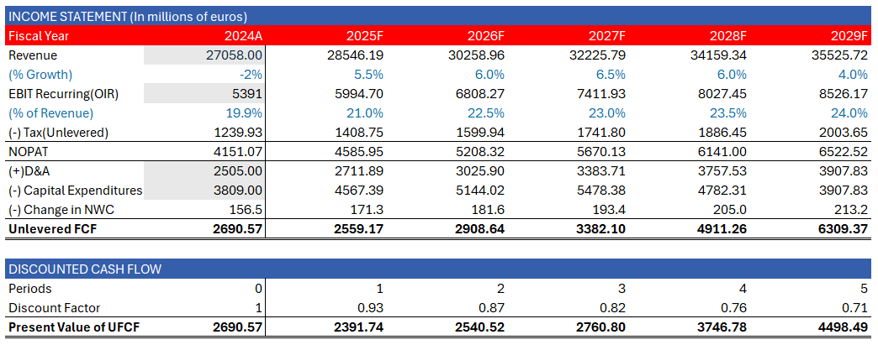
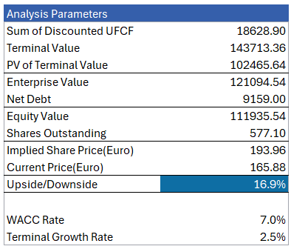
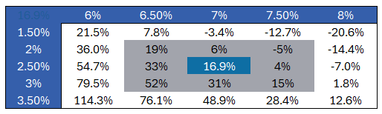
DCF Analysis: Projections
5-Year Revenue Forecasts
Sensitivity Analysis:
Comparable Company Analysis:
WACC
 | Air Liquide | Linde PLC | Air Products & Chemicals | Nippon Sanso Holdings
P/E(TTM Adjusted) | 28.2x | 26.4x | N/A | 21.6x
EV/EBITDA (TTM Adjusted) | 15.3x | 16.9x | 14.7x | 9.47x
Terminal Growth

